Slide 1

What are Control statements in Java and how to Implement them?
Created and Published By : - Girish Rathode

Slide 2
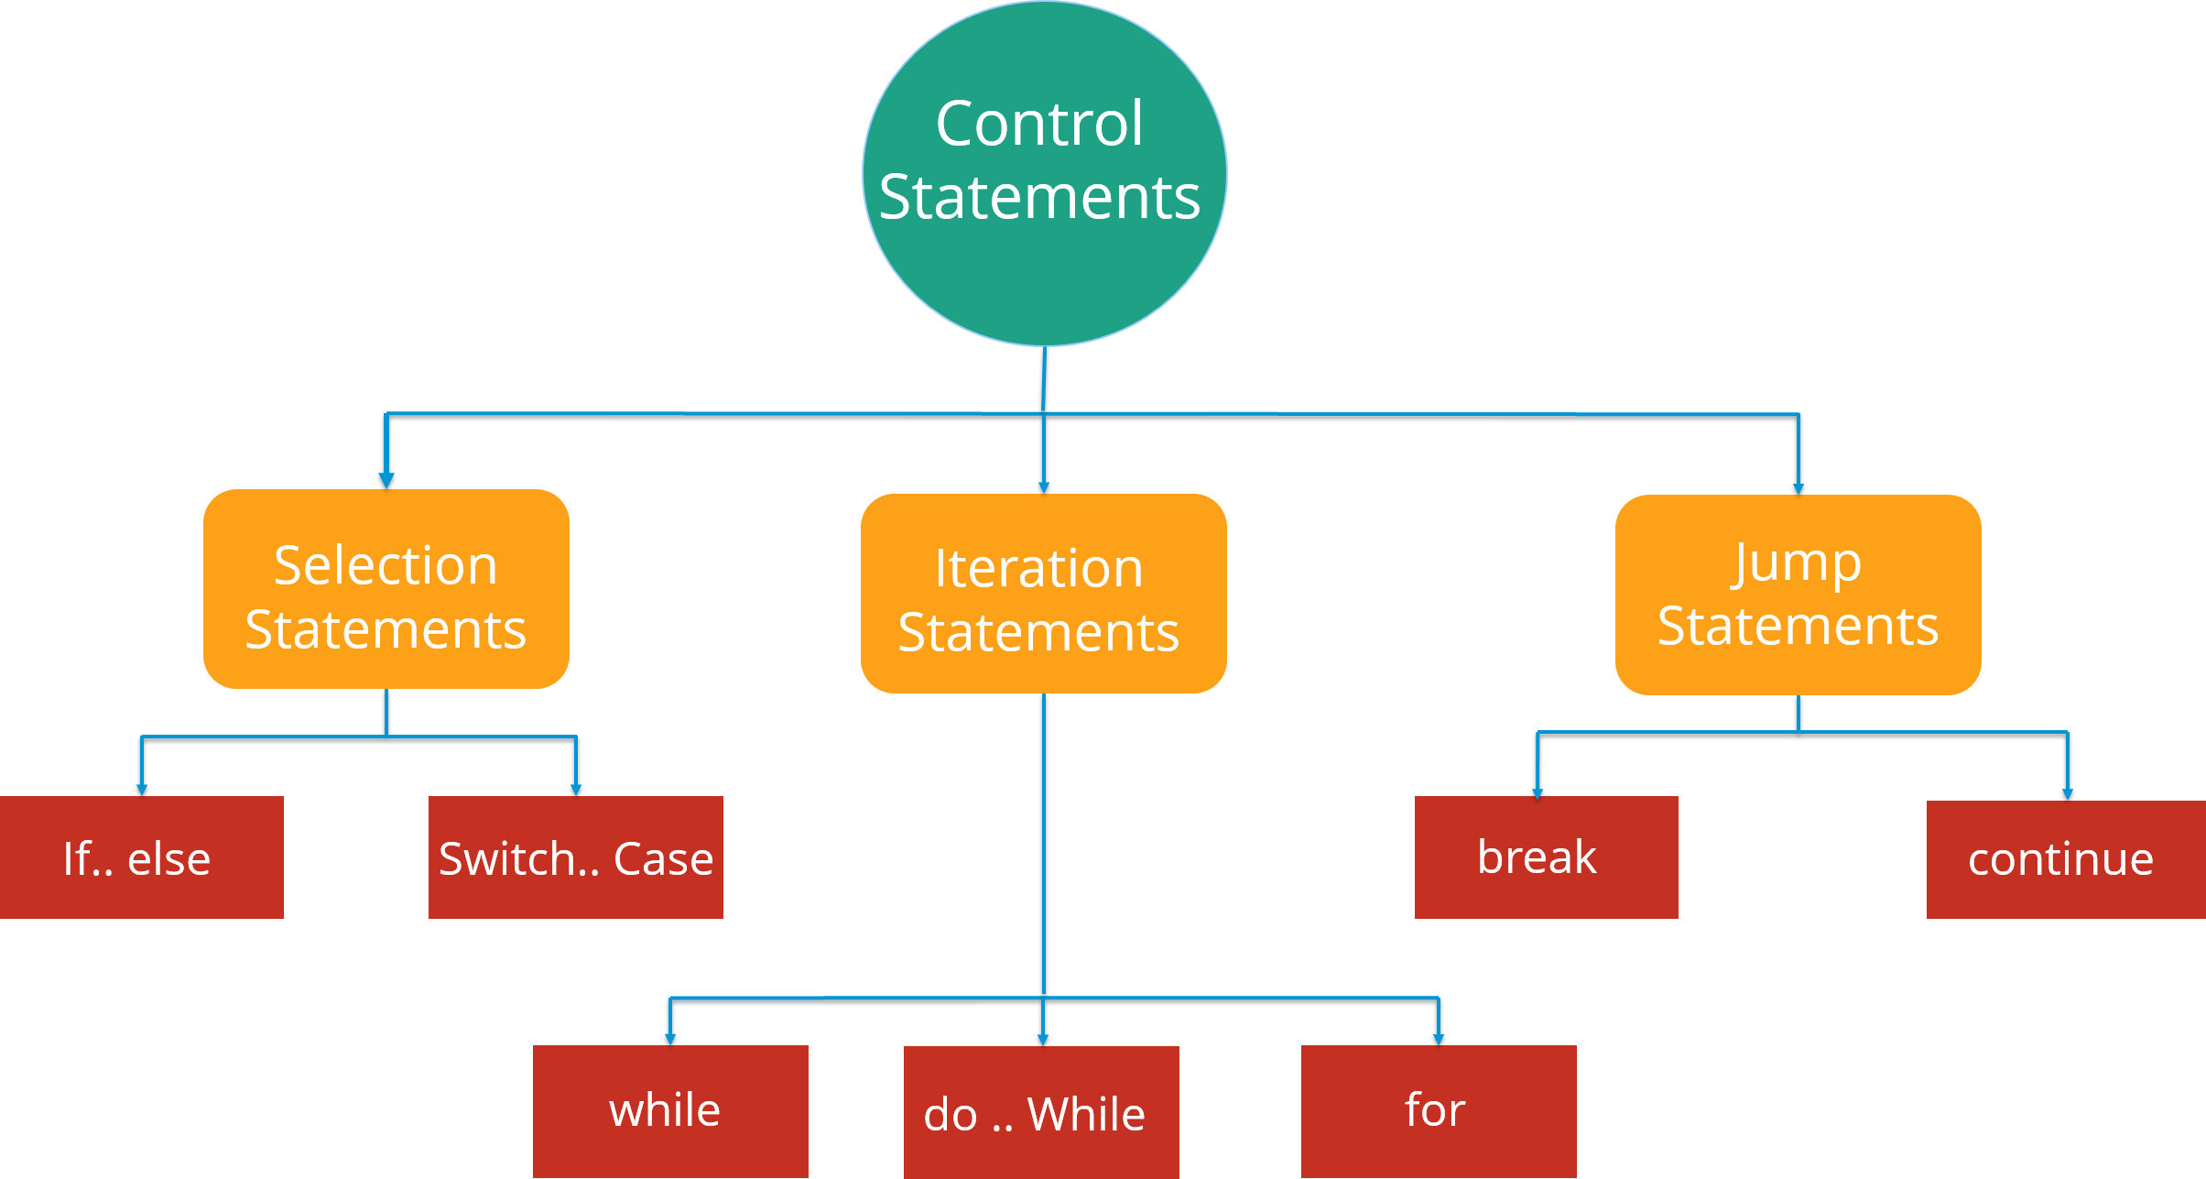
Control statements
Control statements are the statements that define the flow of your program.
There are 3 types of control statements in Java

Slide 3
Java if (if-then) Statement
In Java, the syntax of the if-then statement is:
if (expression)
{
// statements
}
Here expression is a Boolean expression. A Boolean expression returns either true or false.
if the expression is evaluated to true, statement(s) inside the body of if (statements inside parenthesis) are executed
if the expression is evaluated to false, statement(s) inside the body of if are skipped from execution

Slide 4
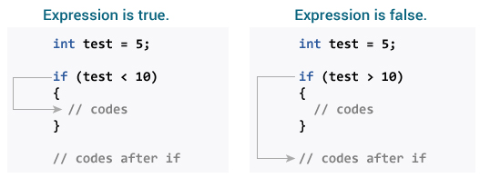
Working of Java if statement

Slide 5
Example 1: Java if Statement
class IfStatement
{
public static void main(String[] args)
{
int number = 10;
// checks if number is greater than 0
if (number > 0)
{
System.out.println("The number is positive.");
}
System.out.println("This statement is always executed.");
}
}
OUTPUT
The number is positive.
This statement is always executed.

Slide 6
Java if...else (if-then-else) Statement
The if statement executes a certain section of code if the test expression is evaluated to true.
However, if the test expression is evaluated to false, it does nothing.
In this case, we can use an optional else block.
Statements inside the body of else block are executed if the test expression is evaluated to false.
This is known as the if-then-else statement in Java.
if (expression) {
// codes
}
else {
// some other code
}

Slide 7
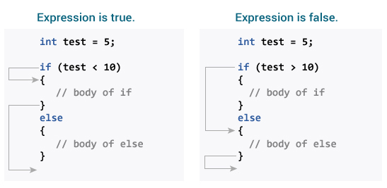
How if...else statement works?

Slide 8
Example 2: Java if else Statement
class IfElse {
public static void main(String[] args) {
int number = 10;
// checks if number is greater than 0
if (number > 0) {
System.out.println("The number is positive.");
}
else {
System.out.println("The number is not positive.");
}
System.out.println("This statement is always executed.");
}
}
Output:
The number is positive.
This statement is always executed.

Slide 9
Java if..else..if Statement
In Java, we have an if...else...if ladder, that can be used to execute one block of code among multiple other blocks.
if (expression1) {
// codes
}
else if(expression2) {
// codes
}
else if (expression3) {
// codes
}
.
.
else {
// codes
}

Slide 10
Java if..else..if Statement
Here, if statements are executed from the top towards the bottom. As soon as the test expression is true, codes inside the body of that the if statement is executed. Then, the control of the program jumps outside the if-else-if ladder.
If all test expressions are false, codes inside the body of else is executed.

Slide 11
Example 3: Java if..else..if Statement
class Ladder {
public static void main(String[] args) {
int number = 0;
// checks if number is greater than 0
if (number > 0) {
System.out.println("The number is positive.");
}
// checks if number is less than 0
else if (number < 0) {
System.out.println("The number is negative.");
}
else {
System.out.println("The number is 0.");
}
}
}
OUTPUT : The number is 0.

Slide 12
Java Nested if..else Statement
In Java, it is also possible to if..else statements inside a if..else statement. It's called nested if...else statement.
Here's a program to find largest of 3 numbers:

Slide 13
class Number {
public static void main(String[] args) {
// declaring double type variables
Double n1 = -1.0, n2 = 4.5, n3 = -5.3, largestNumber;
// checks if n1 is greater than or equal to n2
if (n1 >= n2) {
// if...else statement inside the if block
// checks if n1 is greater than or equal to n3
if (n1 >= n3) {
largestNumber = n1;
}
else {
largestNumber = n3;
}
}
else {
// if..else statement inside else block
// checks if n2 is greater than or equal to n3
if (n2 >= n3) {
largestNumber = n2;
}
else {
largestNumber = n3;
}
}
System.out.println("The largest number is " + largestNumber);
}
}

Slide 14
Java switch Statement
n Java, we have used the if..else..if ladder to execute a block of code among multiple blocks.
However, the syntax of if...else...if ladders are too long.
Hence, we can use the switch statement as a substitute for long if...else...if ladders.
The use of switch statements makes our code more readable.

Slide 15
The syntax of the switch statement is:
switch (variable/expression) {
case value1:
// statements of case1
break;
case value2:
// statements of case2
break;
.. .. ...
.. .. ...
default:
// default statements
}

Slide 16
Java switch Statement
he switch statement evaluates the expression (mostly variable) and compares it with values (can be expressions) of each case label.
Now, if the value matches a certain case label, then all the statements of the matching case label are executed.
For example, if the variable/expression is equal to value2. In this case, all statements of that matching case (statements of case2) are executed.
Notice, the use of break statements in each case. The break statement is used to terminate the execution of the switch statement.
It is important because if break is not used all the statements after the matching case are executed in sequence until the end of the switch statement.

Slide 17
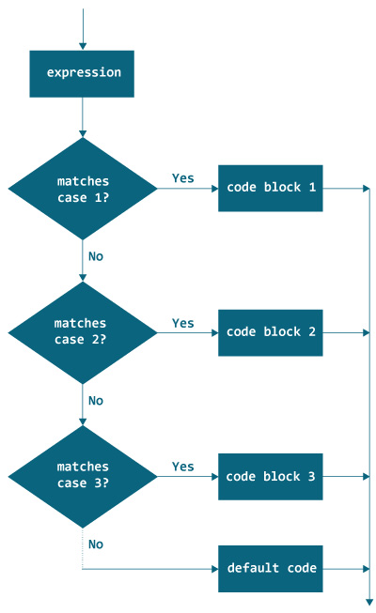
Flowchart of switch Statement

Slide 18
Java switch Statement
Note: The Java switch statement only works with:
Java Primitive data types: byte, short, char, and int
Java Enumerated types
Java String Class
Java Wrapper Classes: Character, Byte, Short, and Integer.

Slide 19
class Main {
public static void main(String[] args) {
int week = 4;
String day;
// switch statement to check day
switch (week) {
case 1:
day = "Sunday";
break;
case 2:
day = "Monday";
break;
case 3:
day = "Tuesday";
break;
// match the value of week
case 4:
day = "Wednesday";
break;
case 5:
day = "Thursday";
break;
case 6:
day = "Friday";
break;
case 7:
day = "Saturday";
break;
default:
day = "Invalid day";
break;
}
System.out.println("The day is " + day);
}
}

Slide 20
Example 2: Making Calculator using the switch statement

Slide 21
import java.util.Scanner;
class Main {
public static void main(String[] args) {
char operator;
Double number1, number2, result;
// create an object of Scanner class
Scanner scanner = new Scanner(System.in);
System.out.print("Enter operator (either +, -, * or /): ");
// ask user to enter operator
operator = scanner.next().charAt(0);
System.out.print("Enter number1 and number2 respectively: ");
// ask user to enter numbers
number1 = scanner.nextDouble();
number2 = scanner.nextDouble();
switch (operator) {
// performs addition between numbers
case '+':
result = number1 + number2;
System.out.print(number1 + "+" + number2 + " = " + result);
break;
// performs subtraction between numbers
case '-':
result = number1 - number2;
System.out.print(number1 + "-" + number2 + " = " + result);
break;
// performs multiplication between numbers
case '*':
result = number1 * number2;
System.out.print(number1 + "*" + number2 + " = " + result);
break;
// performs division between numbers
case '/':
result = number1 / number2;
System.out.print(number1 + "/" + number2 + " = " + result);
break;
default:
System.out.println("Invalid operator!");
break;
}
}
}

Slide 22
Output
Enter operator (either +, -, * or /): *
Enter number1 and number2 respectively: 1.4
-5.3
1.4*-5.3 = -7.419999999999999

Slide 23
Java for Loop
In computer programming, loops are used to repeat a specific block of code until a certain condition is met (test expression is false).
for (initialization; testExpression; update)
{
// codes inside for loop's body
}

Slide 24
Working of for loop
The initialization expression is executed only once.
Then, the test expression is evaluated. Here, test expression is a boolean expression.
If the test expression is evaluated to true, Codes inside the body of for loop is executed. Then the update expression is executed. Again, the test expression is evaluated. If the test expression is true, codes inside the body of for loop is executed and update expression is executed. This process goes on until the test expression is evaluated to false.
If the test expression is evaluated to false, for loop terminates.

Slide 25
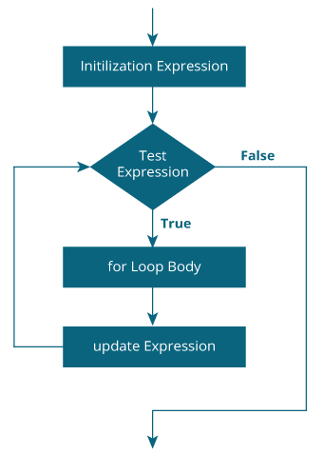
for Loop Flowchart

Slide 26
// Program to print a sentence 10 times
class Loop {
public static void main(String[] args) {
for (int i = 1; i <= 10; ++i) {
System.out.println("Line " + i);
}
}
}

Slide 27
In the above example, we have
initialization expression: int i = 1.e
test expression: i <=10
update expression: ++i
Here, initially, the value of i is 1. So the test expression evaluates to true for the first time. Hence, the print statement is executed. Now the update expression is evaluated.
Each time the update expression is evaluated, the value of i is increased by 1. Again, the test expression is evaluated. And, the same process is repeated.
This process goes on until i is 11. When i is 11, the test expression (i <= 10) is false and the for loop terminates.

Slide 28
Example 2: for Loop
// Program to find the sum of natural numbers from 1 to 1000.
class Number {
public static void main(String[] args) {
int sum = 0;
for (int i = 1; i <= 1000; ++i) {
sum += i; // sum = sum + i
}
System.out.println("Sum = " + sum);
}
}

Slide 29
infinite for Loop
We should be always careful while working with loops.
It is because if we mistakenly set test expression in such a way that it is never false, the for loop will run forever.
// Infinite for Loop
class Infinite {
public static void main(String[] args) {
int sum = 0;
for (int i = 1; i <= 10; --i) {
System.out.println("Hello");
}
}
}
Here, the test expression (i <= 10) is never false and hello is printed infinite number to times (at least in theory).

Slide 30
Java for-each Loop
In Java, there is an alternative syntax of for loop to work with Java arrays and Java collections (known as for-each loop).
For example,
for (int a : array)
{
System.out.println(a);
}

Slide 31
Difference between for loop and for-each loop
To know why the for-each loop is preferred over for loop while working with arrays, let's see the following example.
Here the example shows how we can iterate through elements of an array using the standard for loop.
class ForLoop+
{
public static void main(String[] args) {
char[] vowels = {'a', 'e', 'i', 'o', 'u'};
for (int i = 0; i < vowels.length; ++ i) {
System.out.println(vowels[i]);
}
}
}

Slide 32
Now we will perform the same task using the for-each loop.
class AssignmentOperator {
public static void main(String[] args) {
char[] vowels = {'a', 'e', 'i', 'o', 'u'};
// foreach loop
for (char item: vowels)
{
System.out.println(item);
}
}
}

Slide 33
How for-each loop works?
Here's how the for-each loop works in Java. For each iteration, the for-each loop
iterates through each item in given collections or arrays (collections),
stores each item in a variable (item)
and executes the body of the loop.
Let's make it clear through an example

Slide 34
Example: for-each loop
// The program below calculates the sum of all elements of an integer array.
class EnhancedForLoop {
public static void main(String[] args) {
int[] numbers = {3, 4, 5, -5, 0, 12};
int sum = 0;
for (int number: numbers) {
sum += number;
}
System.out.println("Sum = " + sum);
}
}
OUTPUT : - Sum = 19

Slide 35
In the above program, the execution of the for-each loop looks as:
Iteration | Value
1 | number = 3 and sum = 0 + 3 = 3
2 | number = 4 and sum = 3 + 4 = 7
3 | number = 5 and sum = 7 + 5 = 12
4 | number = -5 and sum = 12 + (-5) = 7
5 | number = 0 and sum = 7 + 0 = 7
6 | number = 12 and sum = 7 + 12 = 19

Slide 36
In the above program, the execution of the for-each loop looks as:
You can see during each iteration, the for-each loop
iterates through each element in the numbers array
stores it in the number variable
and executes the body, i.e. adds the number to sum

Slide 37
Java while Loop
The syntax of while loop in Java is:
while (testExpression)
{
// codes inside the body of while loop
}

Slide 38
How while loop works?
In the above syntax, the test expression inside parenthesis is a boolean expression. If the test expression is evaluated to true,
statements inside the while loop are executed.
then, the test expression is evaluated again.
This process goes on until the test expression is evaluated to false. If the test expression is evaluated to false,
the while loop is terminated.

Slide 39
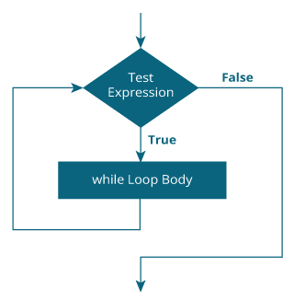
Flowchart of while Loop

Slide 40
Example 1: while Loop
// Program to print line 10 times
class Loop {
public static void main(String[] args) {
int i = 1;
while (i <= 10) {
System.out.println("Line " + i);
++i;
}
}
}
OUTPUT
Line 1 Line 2 Line 3 Line 4 Line 5 Line 6 Line 7 Line 8 Line 9 Line 10

Slide 41
Example 2: Java while Loop
// Program to find the sum of natural numbers from 1 to 100.
class AssignmentOperator {
public static void main(String[] args) {
int sum = 0, i = 100;
while (i != 0) {
sum += i; // sum = sum + i;
--i;
}
System.out.println("Sum = " + sum);
}
}

Slide 42
Java do...while Loop
The do...while loop is similar to while loop with one key difference.
The body of do...while loop is executed for once before the test expression is checked.
Here is the syntax of the do...while loop.
do {
// codes inside body of do while loop
} while (testExpression);

Slide 43
How do...while loop works?
The body of do...while loop is executed once (before checking the test expression). Only then, the test expression is checked.
If the test expression is evaluated to true, codes inside the body of the loop are executed, and the test expression is evaluated again. This process goes on until the test expression is evaluated to false.
When the test expression is false, the do..while loop terminates.

Slide 44
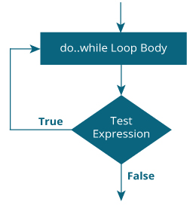
Flowchart of do...while Loop

Slide 45
Example 3: do...while Loop The program below calculates the sum of numbers entered by the user until user enters 0.
import java.util.Scanner;
class Sum {
public static void main(String[] args) {
Double number, sum = 0.0;
// creates an object of Scanner class
Scanner input = new Scanner(System.in);
do {
// takes input from the user
System.out.print("Enter a number: ");
number = input.nextDouble();
sum += number;
} while (number != 0.0); // test expression
System.out.println("Sum = " + sum);
}
}

Slide 46
Output:
Enter a number: 2.5
Enter a number: 23.3
Enter a number: -4.2
Enter a number: 3.4
Enter a number: 0 Sum = 25.0

Slide 47
Infinite while Loop
We should be always careful while working with loops.
It is because if we mistakenly set the test expression in such a way that it is never false, the while and do...while loop will run forever.
// Infinite while loop
while (true) {
// body of while loop
}

Slide 48
The infinite do...while loop works in a similar way as while loop.
// Infinite while loop
int i = 100;
while (i == 100) {
System.out.print("Hey!");
}

Slide 49
Java break Statement
While working with loops, it is sometimes desirable to skip some statements inside the loop or terminate the loop immediately without checking the test expression.
In such cases, break and continue statements are used.
The break statement in Java terminates the loop immediately, and the control of the program moves to the next statement following the loop.
It is almost always used with decision-making statements (Java if...else Statement).
Here is the syntax of the break statement in Java:
break;

Slide 50
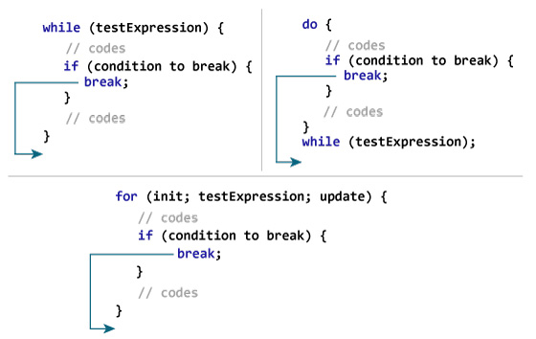
How break statement works?

Slide 51
Example 1: Java break statement
class Test {
public static void main(String[] args) {
// for loop
for (int i = 1; i <= 10; ++i) {
// if the value of i is 5 the loop terminates
if (i == 5) {
break;
}
System.out.println(i);
}
}
}

Slide 52
Java continue Statement
The continue statement in Java skips the current iteration of a loop (for, while, do...while, etc) and the control of the program moves to the end of the loop. And, the test expression of a loop is evaluated.
In the case of for loop, the update statement is executed before the test expression.
The continue statement is almost always used in decision-making statements (if...else Statement).
It's syntax is:
continue;

Slide 53
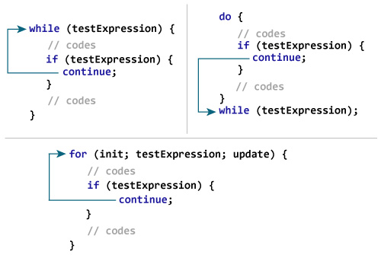
How continue statement works?

Slide 54
Example 1: Java continue statement
class Test {
public static void main(String[] args) {
// for loop
for (int i = 1; i <= 10; ++i) {
// if value of i is between 4 and 9, continue is executed
if (i > 4 && i < 9) {
continue;
}
System.out.println(i);
}
}
}

